Slide 1
Introduction to r
Lucy Sinke - l.j.sinke@lumc.nl

Slide 2

Course overview
2-day Introduction to R – aim to get everyone at the same level
Two lectures today: Introduction to R and RStudio Cloud – set up this and Discord
Three practicals
1
2
3
reproducible work
importing data
data manipulation
data visualization
analysis
writing functions
bioconductor
genomic ranges
basic analysis

Slide 3
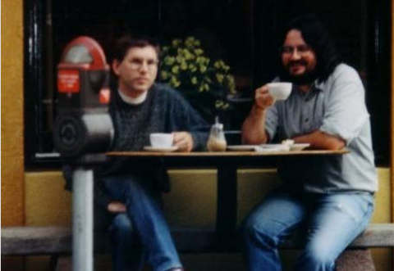
What is R?
Different from most statistical software – you can’t sidestep the blinking cursor
Developed by Ross Ihaka and Robert Gentlemen
Language for statistical analysis and graphics
Inspired by the programming language, S
Maintained by R Development Core Team
Large group of primarily statisticians
Source - R. Ihaka

Slide 4
THE BENEFITS OF R
Free – especially attractive compared to other software
No hidden costs
Open source - source code can be viewed and modified by anyone
Actively maintained
Stable and reliable
Instead of relying on a small team of developers
Bugs and issues can be detected and resolved far quicker

Slide 5
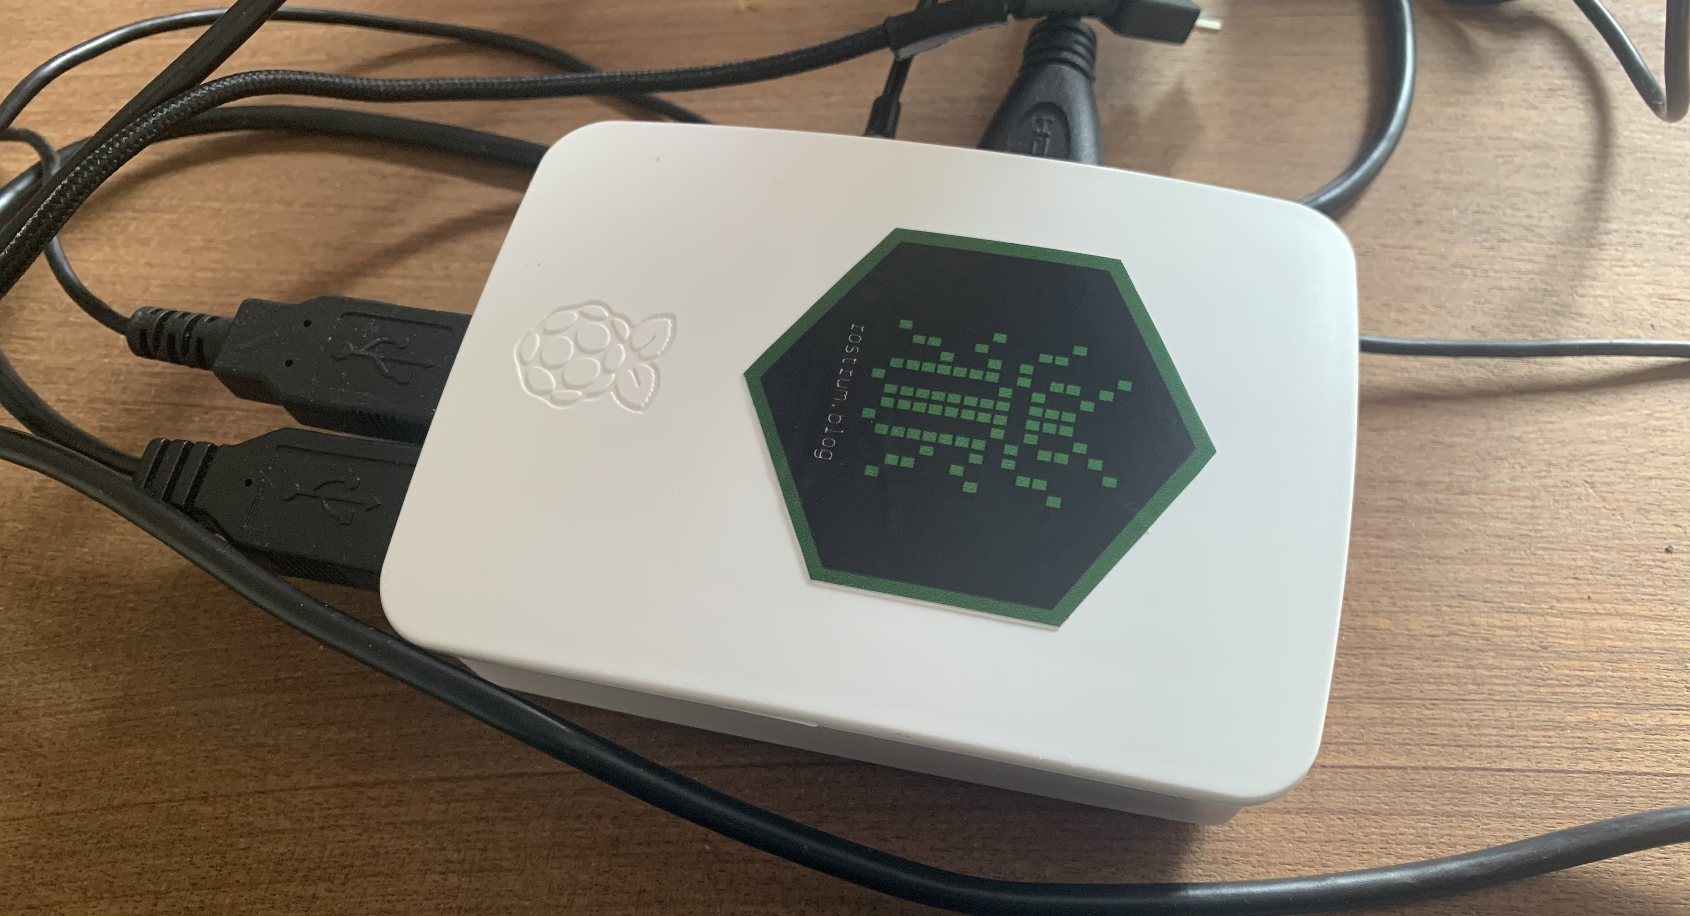
THE BENEFITS OF R
Compiles and runs on multiple operating systems
Can even port it to different hardware
Large and active community
Happy to provide support and information
Scripting language - write your own functions
Novel methods quickly developed into packages by users
Versatile and stays up-to-date – other programs may never get niche methods

Slide 6
THE BENEFITS OF R
Integrative - plays well with others
Individuals extended R to nest into their current workflows
Can read in multiple data types - html, sav, databases, IDAT
Implement other languages - C, Python, Java – no need to import / export
Output many file formats - markdown, sav, pdfs

Slide 7
THE BENEFITS OF R
Easy parallelization - meaning faster calculations
Optimized for vector operations - better than scalar languages or loops
182
9
17
95
320
-2
74
-294
82
963

Slide 8
THE BENEFITS OF R
CPU: 1 instruction per cycle, 3 operands per instruction
182
9
17
95
320
-2
74
-294
82
963

Slide 9
THE BENEFITS OF R
CPU: 1 instruction per cycle, 3 operands per instruction
Scalar language or loop:
9 instructions = 9 cycles
182
74
17
74
95
74
-2
74
-294
74
963
74
9
74
82
74
320
74

Slide 10
THE BENEFITS OF R
CPU: 1 instruction per cycle, 3 operands per instruction
Vectorized language:
1 instruction
9 operands = 3 cycles
3 times as fast!
[182, 95, -294, 9, 320, 17, -2, 963, 82]
74
[182, 95, -294]
74
[9, 320, 17]
74
[182, 95, -294]
74

Slide 11
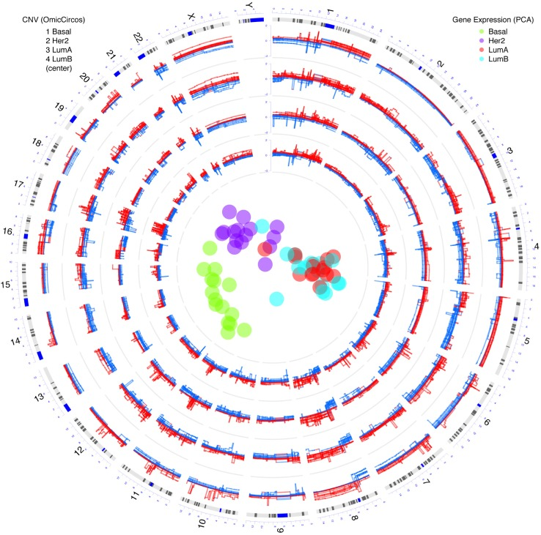

THE BENEFITS OF R
Stunning graphics – e.g. geo-spatial data
Bioinformatics packages – e.g. OmicCircos
Used by Google, Twitter, and Facebook
Build interactive web applications with Shiny
Hu et al., 2014

Slide 12

THE disadvantages OF R
Working in R can be quite frustrating
Syntax – unintuitive and inconsistent
Steep learning curve - command-line type user interface
Requires experience - multiple options for any problem
Continuously changing - need to stay up-to-date
Nothing to stop packages using the same named functions
No official support - sometimes poor documentation

Slide 13

bioconductor
Software repository - over 1,500 bioinformatics packages
Analyse, annotate, and visualize high-throughput -omic data
Have some quality standards
Obligatory vignettes - high quality documentation
Daily build system - guarantees software works
Basics introduced in the 3rd practical

Slide 14
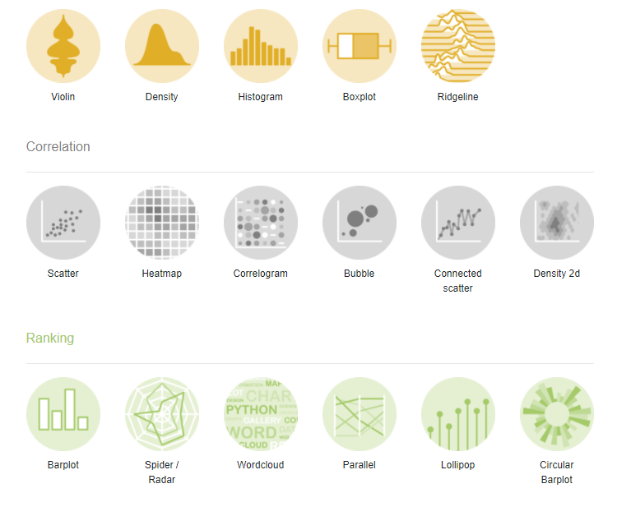
resources
R graph gallery: http://www.r-graph-gallery.com/
R web application: https://shiny.rstudio.com/gallery/
Bioconductor: https://bioconductor.org/
Online courses: https://www.datacamp.com/
Books – often online using R Bookdown
R course at LUMC

Slide 15

resources
R graph gallery: http://www.r-graph-gallery.com/
R web application: https://shiny.rstudio.com/gallery/
Bioconductor: https://bioconductor.org/
Online courses: https://www.datacamp.com/
Books – often online using R Bookdown
R course at LUMC

